Slide 1


Running ROS across multiple machines
Hello Robot can you hear me?
Yes, I can hear you
Move forward
Okay!!

Slide 2
Running ROS across multiple machines
Hello Robot can you hear me?
Yes, I can hear you
Move forward
Okay!!

Slide 3
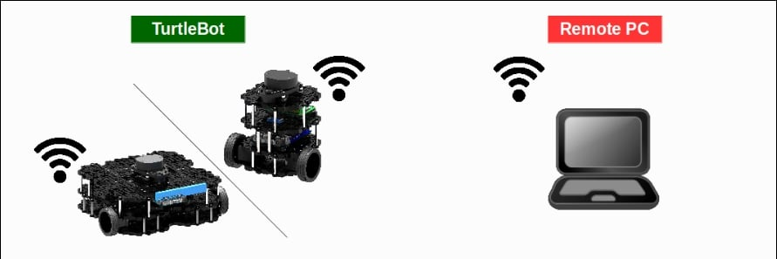
Controlling Slave robots with Master robot via IP on the same LAN

Slide 4
What do we want to achieve?
ROS on Multiple Computers | Connecting Raspberry Pi with PC over LAN
Steps
Connect both PCs on the same network.
Connect the slave robot to the master robot.

Slide 5
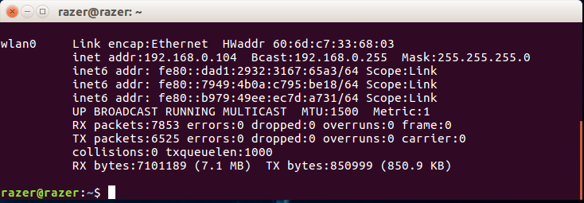
In this case, the IP address of my Slave is 192.168.0.109
So finally
Master PC IP: 192.168.0.104
Slave PC IP: 192.168.0.109
$ ifconfig

Slide 6
Configuring the .bashrc file.
$ gedit .bashrc
export ROS_MASTER_URI=http://localhost:11311/
export ROS_HOSTNAME=192.168.0.104
export ROS_IP=192.168.0.104
$ nano .bashrc
export ROS_MASTER_URI=http://192.168.0.104:11311/
export ROS_HOSTNAME=192.168.0.109
export ROS_IP=192.168.0.109

Slide 7
Configuring the .bashrc file.
$ gedit .bashrc
export ROS_MASTER_URI=http://localhost:11311/
export ROS_HOSTNAME=192.168.0.104
export ROS_IP=192.168.0.104
$ nano .bashrc
export ROS_MASTER_URI=http://192.168.0.104:11311/
export ROS_HOSTNAME=192.168.0.109
export ROS_IP=192.168.0.109

Slide 8
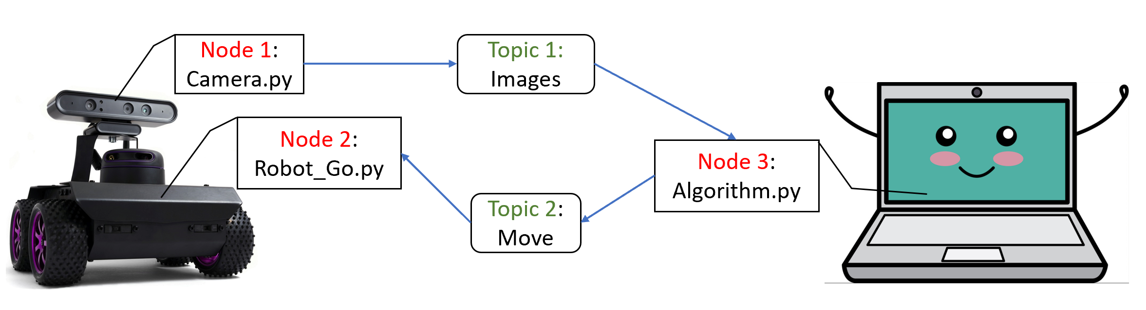

Slide 9
What do we want to achieve?
ROS on Multiple Computers | Connecting Raspberry Pi with PC over LAN
Steps
Connect both PCs on the same network.
Connect the slave robot to the master robot.
Control slave robot.
Visualize the slave on the master workspace

Slide 10


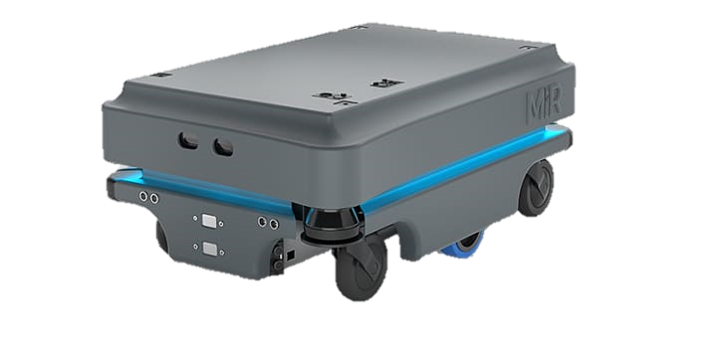
Office / Master
Store / Slave

Slide 11

THANK YOU
01211626904
Robotics Corner
Robotics Corner
Robotics Corner
Robotics Corner

Slide 12
THANK YOU
01211626904
Robotics Corner
Robotics Corner
Robotics Corner
Robotics Corner

